Slide 1

A Data Analysis Project on Credit Card Customers leaving the Bank
By: Favour Aremu

Slide 2


About Me – Favour Aremu
Graduate of Economics
9 years+ experience within the Banking Sector
Upskilling to be ready for the future of work
Enjoy the use of data to tell stories that will in turn solve problems

Slide 3
Background
A manager at the bank is disturbed with more and more customers leaving their credit card services.
The dataset provided consist of over 10,000 customers with varying demographics, as well as data regarding their relationship with the bank. The dataset was taken from ;
https://www.kaggle.com/datasets/sakshigoyal7/credit-card-customers

Slide 4
Task
The objective of this project is to answer a few questions regarding the data set and specifically the Churning Customers.
These questions are;
How much of Bank customers have churned ?
How churn (attrition) looks like across different demographics?
What the average utilisation is?

Slide 5



What I did?
For this project, I used Ms Excel to analyse the data, SQL to manipulate dataset and Power BI to create visuals for everyone to understand the dataset easily.
This is an attempt to bring to the fore skills that have gained during this 4 month Data Bootcamp to answer the questions already outlined
This Photo by Unknown Author is licensed under CC BY-NC-ND
This Photo by Unknown Author is licensed under CC BY-NC-ND
This Photo by Unknown Author is licensed under CC BY-SA-NC

Slide 6
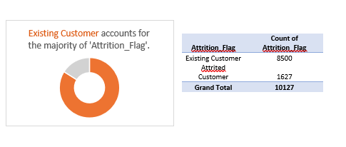
Ms Excel Analysis
Using the MIN/MAX function to get the lowest and highest credit limit, I used the function like so
=MIN(N2:N10128) – £1,438.3
=MAX(N2:N10128) - £3,4516
Using the SUM Function to get the Total Revolving Balance, I used the function like so =SUM(O2:O10128) = £11,775,818
Using COUNTIF to breakdown no of Existing customer & Attrited Customer =COUNTIF (B2:B10128, Existing Customer) - 8500
=COUNTIF (B2:B10128, Attrited Customer) -1627

Slide 7
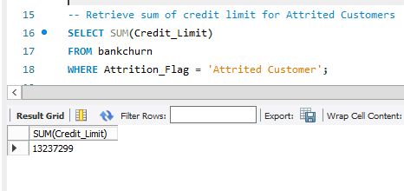
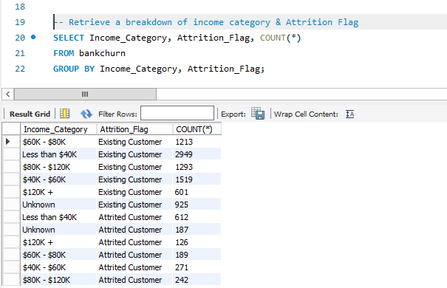
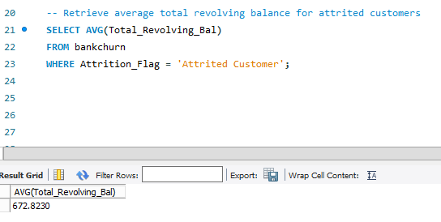
SQL Analysis

Slide 8
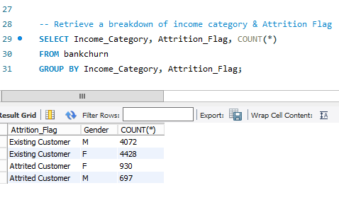
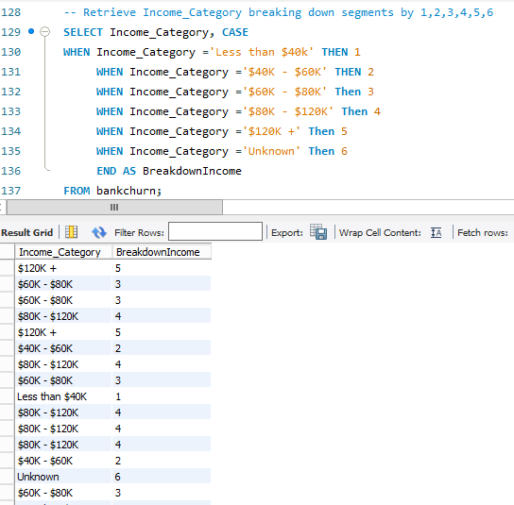
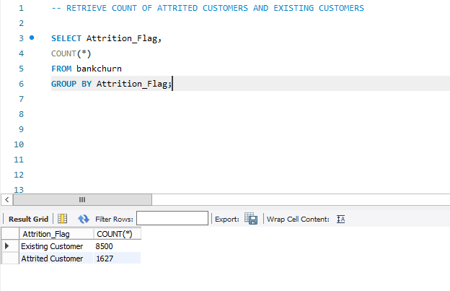
SQL Analysis

Slide 9
Now let’s see some Interesting Visuals using the amazing Power BI

Slide 10
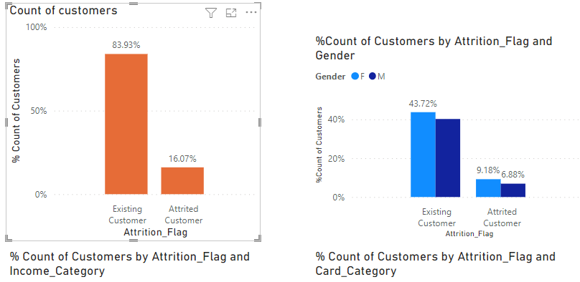
Customers and gender breakdown

Slide 11
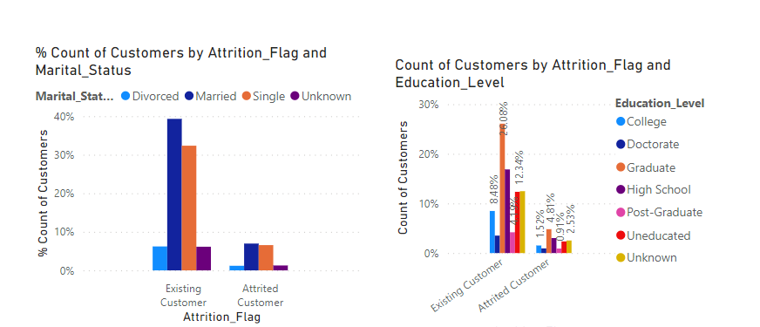

Customers breakdown by Marital Status & Educational Level

Slide 12
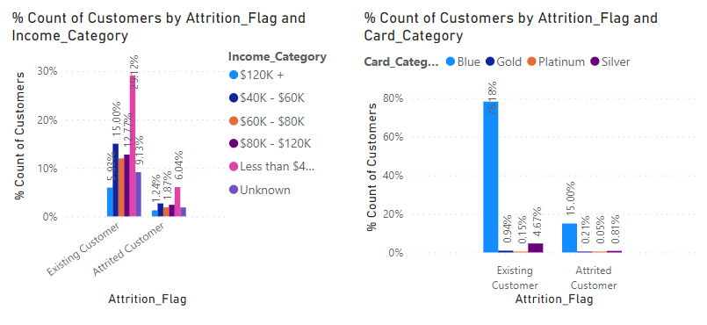
Customers analysis by Income & Card category

Slide 13
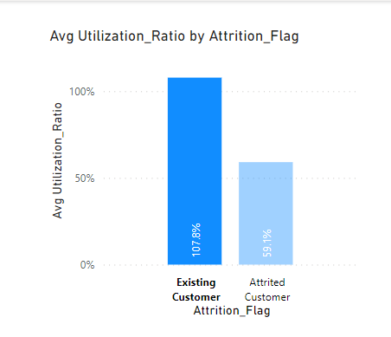
Average card utilization by customer segments

Slide 14
A comparison
Attrited Customers
Existing Customers
16.07% of customers are attrited
14% are female, 6.9% are male
Customers with a College qualification has the highest churn of 4.8%
The less than 40k income bracket accounts for most of the customers with 9.3%
Blue card holders account for the highest no of customers with 20%
Customers with a Married status of “married” have the highest number of churn
The average card utilization is 59%
83.93% of customers are in this segment
43% are female, 36% male
Customers with a college qualification has the highest custom by 26%
The less than 40k income bracket accounts for most of the customers with 30%
Blue card holders account for the highest no of customers with 73%
Customers with a Marital status of “married” account for the highest number in this segment
The average card utilization is 108%

Slide 15
Summary
A little over 16% of customers are not using their credit cards. These attriting customers are the average regular customers compared with the current existing customers as the above analysed data shows.
It is recommended that the Bank reaches out to these customers offering an incentive for them to utilise their cards and hence,stay with the Bank

Slide 16
Thank you for your time today!

